Slide 1
Continuous Models vs Discrete Models

Slide 2

Continuous Models
General setting (dynamics of parameters over time):
$$\frac{dX}{dt}=f(X,t)$$
Simplest continuous model:
$$\frac{dX}{dt}=const$$

Slide 3
Continuous model solution
Python-function odeint( f(x, t), x0, t); f(x, t) – model, x – vector of variables (may be scalar value)
The function is in scipy.integrate and is loaded with the command
from scipy.integrate import *
or
from scipy.integrate import odeint

Slide 4
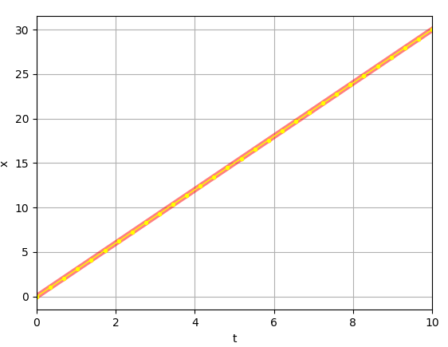
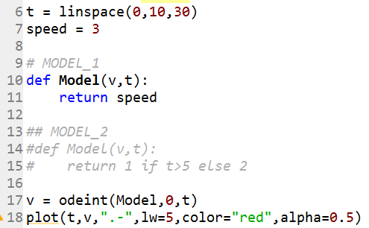
Solution example
Python code:
Visualization:

Slide 5
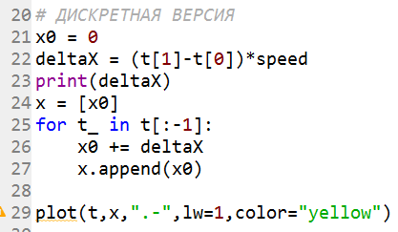


Discrete analog of the continuous model
Formal description:
Implementation (python code):
$$x_{i}=x_{i−1}+∆x$$
$$∆x=∆x∙const$$

Slide 6
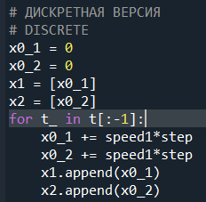
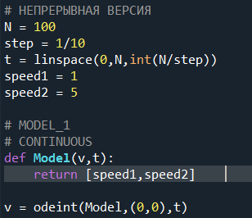
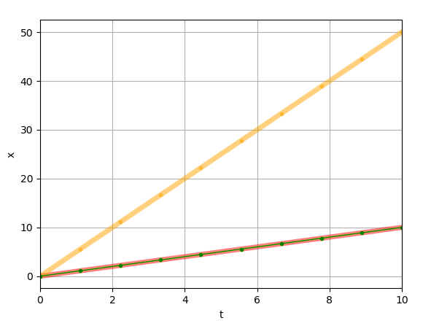

Systems of equations
Continuous mode
Discrete model
$$\left\{\begin{aligned}&\frac{dX}{dt}=const1 \\ &\frac{dY}{dt}=const2\end{aligned}\right.$$

Slide 7

Task
Compare continuous and discrete implementations of the following model:
write discrete equations
plot the result.
Hint: use example2_system.py
$$\left\{\begin{aligned}&\frac{dX}{dt}=const1+Y \\ &\frac{dY}{dt}=const2−X\end{aligned}\right.$$

